Slide 1
Poverty & Fast Food
Angie, Brett, CJ, Kenn

Slide 2


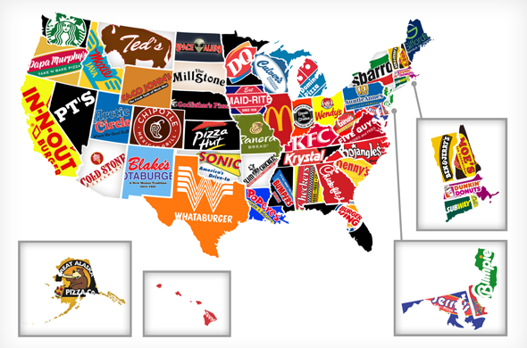

What We Are Looking For
Number of restaurants vs. poverty level
Why understanding this is important
What we can learn from the data, no matter the outcome
This Photo by Unknown Author is licensed under CC BY-NC-ND

Slide 3
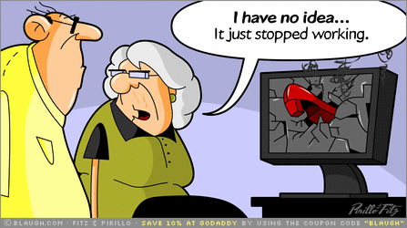
What We Did
API
MongoDB
Leaflet plugin w/ sidebar
Scrapped Data
This Photo by Unknown Author is licensed under CC BY-SA-NC

Slide 4

The Site
Angies Map
This Photo by Unknown Author is licensed under CC BY-SA

Slide 5
References

